Slide 1




Slide 2

DECISION MAKING
1.4

Slide 3

TEST TIME ON DECISION MAKING 3
QR CODE:

Slide 4

CONCEPTS
Nature and Characteristics of Planning:
Notes:
Planning is concerned with the establishment of objectives of an enterprise and finding out the way of realisation of those objectives. However, without setting the objectives there is nothing to organise, direct or control. Therefore, every organisation is required to specify what it wants to achieve. Planning is basically related with this aspect.

Slide 5

CONCEPTS
The nature and characteristics of planning may be stated as follows:
1. Intellectual Process:
Notes:
Planning is an intellectual and rational process. Planning is a mental exercise involving imagination, foresight and sound judgement. It requires a mental disposition of thinking before’ acting in the light of facts rather than guess. The quality of planning depends upon the abilities of the managers who are required to collect all relevant facts, analyse and interpret them in a correct way.
How far into the future a manager can see and with how much clarity he will depend on his intellectual calibre, are chalked out through planning process. In thinking of objectives, alternative courses of action and, above all, in making decision for choosing certain alternatives, the planner goes through an intellectual process.

Slide 6

CONCEPTS
2. Goal-orientation:
Notes:
All planning is linked up with certain goals and objectives. It follows, therefore, that every plan must contribute in some positive way to the accomplishment of group objectives. Planning has no meaning without being related to goals and objectives. It must bridge the gap between where we are and where we want to go at the minimum cost.

Slide 7
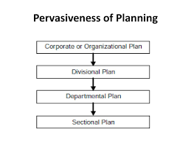
CONCEPTS
.
4. Pervasiveness:
Notes:
Planning pervades all managerial activities. It is the job of all managers in all types of organisation. It is undertaken at all segments and levels of the organisation—from the general manager to the foreman. Whatever be the nature of activity, management starts with planning. The character and breadth of planning will, of course, vary from one job to another—depending on the level of management.

Slide 8

CONCEPTS
5. Uniformity:
Notes:
There may be separate plans prepared in different levels in the organisation, but all the sub-plans must be united with the general plan so as to make up a comprehensive plan for operation at a time. So, uniformity must be there in all levels of planning to match the general plan.

Slide 9

CONCEPTS
CLOCKS
6. Continuity:
Notes:
To keep the enterprise as a going concern without any break, it is essential that planning must be a continuous process. So, the first plan must follow the second plan and the second plan the third and so on in never-ending series in quick succession.

Slide 10
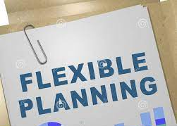
CONCEPTS
7. Flexibility:
Notes:
Plans should not be made rigid. It should be as flexible as possible to accommodate all possible changes in the enterprise with a view to coping with the changing conditions in the market. In fact, planning is a dynamic activity.

Slide 11
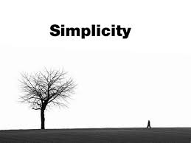
CONCEPTS
8. Simplicity:
Notes:
The language of the work schedule or programme in the planning should be simple so that each and every part of it may easily be understood by the employees at different levels, specially at the lower level.

Slide 12


CONCEPTS
9. Precision:
Notes:
Precision is the soul of planning. This gives the planning exact, definite, and accurate meaning in its scope and content. Any mistake or error in planning is sure to upset other functions of management and, thus, precision is of utmost importance in every kind of planning.

Slide 13

Question: 01
CONCEPTS
10. Feasibility:
Notes:
Planning is neither poetry nor philosophy. It is based on facts and experience, and thereby realistic in nature. It represents a programme which is possible to execute with more or less existing resources.

Slide 14
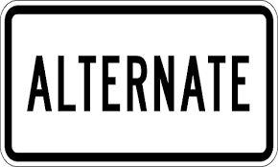
CONCEPTS
11. Choice among Alternative Courses:
Notes:
Planning involves selection of suitable course of action from several alternatives. If there is only one way of doing something there is no need of planning. Planning has to find out several alternatives, estimate the feasibility and profitability of the different alternatives, and to choose the best one out of them.

Slide 15
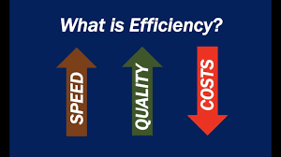
CONCEPTS
12. Efficiency:
Notes:
Planning is directed towards efficiency. A plan is a course of action that shows promise of optimizing return at the minimum expense of inputs. In planning, the manager evaluates the alternatives on the basis of efficiency. A good plan should not only attain optimum relationship between output and input but should also bring the greatest satisfaction to those who are responsible for its implementation.

Slide 16

Question: 16
CONCEPTS
13. Inter-dependence:
Notes:
The different departments may formulate different plans and programmes for their integration in the overall planning. But sectional plans cannot but be inter-dependent. For example, production planning depends upon sales planning—and vice versa.
Again, planning for purchase of raw materials, employment of labour, etc. cannot be an isolated act apart from sales planning and production planning. Planning is a structured process and different plans constitute a hierarchy. Different plans are interdependent and inter-related. Every lower-level plan serves as a means towards the end of higher plans.

Slide 17

Question: 09
CONCEPTS
14. Forecasting:
Notes:
Above all, no planning can proceed without forecasting—which means assessing the future and making provision for it. Planning is the synthesis of various forecasts—short-term or long-term, special or otherwise. They all merge into a single programme and act as a guide for the whole concern.

Slide 18
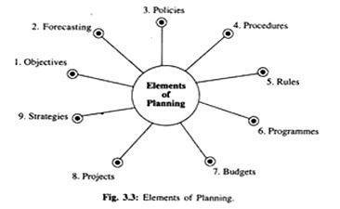
Question: 09
CONCEPTS
Elements of Planning:
Planning as a managerial process consists of the following elements or components:

Slide 19

Question: 09
CONCEPTS
1. Objectives:
Notes:
The important task of planning is to determine the objectives of the enterprise. Objectives are the goals towards which all managerial activities are aimed at. All planning work must spell out in clear terms the objectives to be realised from the proposed business activities. When planning action is taken, these objectives are made more concrete and meaningful. For example, if the organisational objective is profit earning, planning activity will specify how much profit is to be earned looking into all facilitating and constraining factors.

Slide 20

Question: 09
CONCEPTS
2. Forecasting:
Notes:
It is the analysis and interpretation of future in relation to the activities and working of an enterprise. Business forecasting refers to analysing the statistical data and other economic, political and market information for the purpose of reducing the risks involved in making business decisions and long range plans. Forecasting provides a logical basis for anticipating the shape of the future business transactions and their requirements as to man and material

Slide 21

Question: 09
CONCEPTS
3. Policies:
Notes:
Planning also requires laying down of policies for the easy realisation of the -objectives of business. Policies are statements or principles that guide and direct different managers at various levels in making decisions. Policies provide the necessary basis for executive operation. They set forth overall boundaries within which the decision-makers are expected to operate while making decisions. Policies act as guidelines for taking administrative decisions.
In a big enterprise, various policies are formulated for guiding and directing the subordinates in different areas of management. They may be production policy, sales policy, financial policy, personnel policy etc. But these different policies are co-ordinated and integrated in such a way that they ensure easy realisation of the ultimate objectives of business. Policies should be consistent and must not be changed frequently.

Slide 22
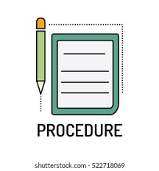
Question: 09
CONCEPTS
4. Procedures:
Notes:
Planning also requires laying down of policies for the easy realisation of the -objectives of business. Policies are statements or principles that guide and direct different managers at various levels in making decisions. Policies provide the necessary basis for executive operation. They set forth overall boundaries within which the decision-makers are expected to operate while making decisions. Policies act as guidelines for taking administrative decisions.
In a big enterprise, various policies are formulated for guiding and directing the subordinates in different areas of management. They may be production policy, sales policy, financial policy, personnel policy etc. But these different policies are co-ordinated and integrated in such a way that they ensure easy realisation of the ultimate objectives of business. Policies should be consistent and must not be changed frequently.
The manner in which each work has to be done is indicated by the procedures laid down. Procedures outline a series of tasks for a specified course of action. There may be some confusion between policies and procedures. Policies provide guidelines to thinking and action, but procedures are definite and specific steps to thinking and action. For example, the policy may be the recruitment of personnel from all parts of the country; but procedures may be to advertise and invite applications, to take interviews and offer appointment to the selected personnel.
Thus, procedures mean definite steps in a chronological sequence within the area chalked out by the policies. In other words, procedures are the methods by means of which policies are enforced. Different procedures are adopted in different areas of business activities. There may be production procedure, sales procedure, purchase procedure, personnel procedure etc.
Production procedure involves manufacturing and assembling of parts; sales procedure relates to advertising, offering quotations, securing and execution of orders; purchase procedure indicates inviting tenders, selecting quotations, placing orders, storing the goods in go-down and supplying them against requisition to different departments and personnel procedure is the recruitment, selection and placement of workers to different jobs.

Slide 23

Question: 09
CONCEPTS
5. Rules:
Notes:
A rule specifies necessary course of action in a particular situation. It acts as a guide and is essentially in the nature of a decision made by the management authority. This decision signifies that a definite action must be taken in respect of a specific situation. The rules prescribe a definite and rigid course of action to be followed in different business activities without any scope for deviation or discretion.
Any deviation of rule entails penalty. Rule is related to parts of a procedure. Thus, a rule may be incorporated in respect of purchase procedure that all purchases must be made after inviting tenders. Similarly, in respect of sales procedure, rule may be enforced that all orders should be confirmed the very next day.

Slide 24

Question: 09
CONCEPTS
6. Programmes:
Notes:
Programmes are precise plans of action followed in proper sequence in accordance with the objectives, policies and procedures. Programmes, thus, lead to a concrete course of inter-related actions for the accomplishment of a purpose. Thus, a company may have a programme for the establishment of schools, colleges and hospitals near about its premises along with its expanding business activities.
Programmes must be closely integrated with the objectives. Programming involves dividing into steps the activities necessary to achieve the objectives, determining the sequence between different steps, fixing up performance responsibility for each step, determining the requirements of resources, time, finance etc. and assigning definite duties to each part.

Slide 25

Question: 09
CONCEPTS
7. Budgets:
Notes:
Budget means an estimate of men, money, materials and equipment in numerical terms required for implementation of plans and programmes. Thus, planning and budgeting are inter-linked. Budget indicates the size of the programme and involves income and outgo, input and output. It also serves as a very important control device by measuring the performance in relation to the set goals. There may be several departmental budgets which are again integrated into the master budget.

Slide 26

Question: 09
CONCEPTS
8. Projects:
Notes:
A project is a single-use plan which is a part of a general programme. It is part of the job that needs to be done in connection with the general programme. So a single step in a programme is set up as a project. Generally, in planning a project, a special task force is also envisaged.
It is a scheme for investing resources which can be analysed and appraised reasonably and independently. A project involves basically the investment of funds, the benefits from which can be accrued in future. Examples of such investment may be outlays on land, building, machinery, research and development, etc. depending upon the situation.

Slide 27

Question: 09
CONCEPTS
9. Strategies:
Notes:
Strategies are the devices formulated and adopted from the competitive standpoint as well as from the point of view of the employees, customers, suppliers and government. Strategies thus may be internal and external. Whether internal or external, the success of the plans demands that it should be strategy-oriented.
The best strategy of planning from the competitive standpoint is to be fully informed somehow about the planning ‘secrets’ of the competitors and to prepare its own plan accordingly. Strategies act as reserve forces to overcome resistances and reactions according to circumstances. They are applied as and when required.

Slide 28
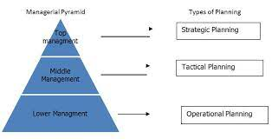
Question: 09
CONCEPTS
Levels of Planning
Notes:
In management theory, it is usual to consider that there are three basic levels of planning, though in practice there may be more than three levels of management and to an extent, there will be some overlapping of planning operations.

Slide 29
CONCEPTS
Question: 09
The three levels of planning are discussed below:
Top level planning: also known as overall or strategic planning, top level planning is done by the top management, i.e., board of directors or governing body. It encompasses the long-range objectives and policies or organisation and is concerned with corporate results rather than sectional objectives. Top level planning is entirely long-range and inextricably linked with long-term objectives. It might be called the ‘what’ of planning.
Second level planning: also known as tactical planning, it is done by middle level managers or departmental heads. It is concerned with ‘how’ of planning. It deals with development of resources to the best advantage. It is concerned mainly, not exclusively, with long-range planning, but its nature is such that the time spans are usually shorter than those of strategic planning. This is because its attention are usually devoted to the step-by-step attainment of the organisation’s main objective. It is, in fact, oriented to functions and departments rather than to the organisation as a whole.
Third level planning: also known as operational or activity planning, it is the concern of departmental managers and supervisors. It is confined to putting into effect the tactical or departmental plans. It is usually for a short-term and may be revised quite often to be in tune with the tactical planning.

Slide 30
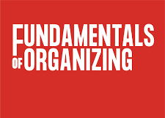
Question: 09
CONCEPTS
Fundamentals of Organizing
Notes:
rganizing is an important managerial function. If managerial planning focuses on deciding what to do, organizing focuses on how to do it. Thus, after a manager has set goals and developed a workable plan, the next managerial task is to organize people and groups to carry out the plan.
Organizing is the process of identifying and grouping the work to be performed, defining and delegating authority, and establishing relationships to enable people to work together to achieve the organization's objectives. In essence, organizing involves the grouping of activities and resources in a logical fashion. The various approaches to the division and coordination of work activities and resource allocation fall under two broad categories: the classical closed systems and the open systems. Closed systems involve sets of interacting elements operating without any exchange with the environment in which they exist. Open systems consists of sets of elements that interact with each other and with the environment, and whose structure evolves over time as a result of these interactions. The span of management refers to the number of subordinates who report directly to a specific manager. According to Graicunas, what counts is the number of relationships among those who report to a manager, not the number of people who report to him. Spans of management have a direct affect on the number of hierarchical levels in an organization.
A tall structure consists of many hierarchical levels with narrow spans of control, whereas a flat structure contains fewer hierarchical levels. The process of organizing consists of six steps - defining the firm's objectives, framing supporting objectives and policies, identifying and classifying the required activities, grouping the activities according to the available human and material resources, delegating authority, and horizontal and vertical coordination of the various groups in the organization.
Effective organizing has many benefits. It helps individuals clearly visualize the tasks they are expected to accomplish. It supports planning and control activities. Organizing also creates channels of communication and helps in maintaining the logical flow of work activities. The process of organizing ensures efficient use of resources and helps avoid conflicts and duplication of effort. It coordinates diverse activities and builds harmonious relationships among members of the organization. The process of organizing helps managers to focus on tasks that are logically related to a common goal.

Slide 31
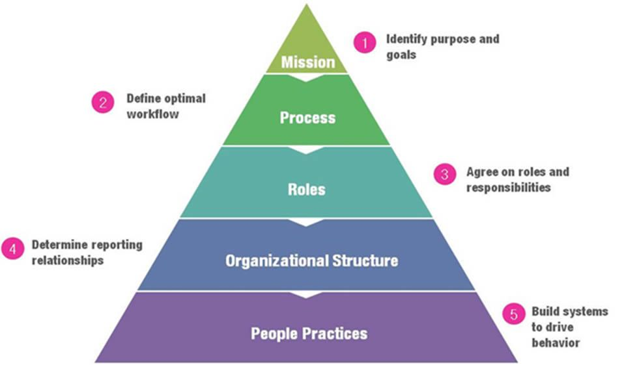
Question: 09
CONCEPTS
Organizational Design and Structure; Definition, Elements, Types, Pros, Cons
Notes:
Let us try to understand the term “Organization Design and Structure.” The structure of any building depends on its base or foundation. A strong foundation and a basic structure are critical to making a building strong. Although it is possible to redesign and restructure a building, if the base is weak, the whole structure of a building will be unstable.
We can clearly see how important a foundation is. Moreover, foundation and design are inter-related to each other. Similarly, from an organizational point of view, the foundation is the ‘Organizational Structure’ which demonstrates different roles, hierarchy levels and terms, and conditions in an organization. ‘Organisational Design’ encompasses restructuring and destructuring roles, hierarchy level, terms, and conditions as per business or organizational needs.

Slide 32

Question: 09
CONCEPTS
Definition
Notes:
As stated above, the organization structure is the system which describes the organizational hierarchy in terms of different functions, roles, responsibilities, supervision, etc. It demonstrates different concerns including different roles of the employees, job descriptions, job functions, decision-making authorities, reporting structure, allocation of tasks in the department, individuals, project team, branch, etc.
The organizational structure also defines the flow of information between different levels of an organization, clarity of job of each employee, and its fitment in the overall system which motivates the employees to work efficiently by keeping their morale high; hence, increasing the overall productivity of an organization.

Slide 33
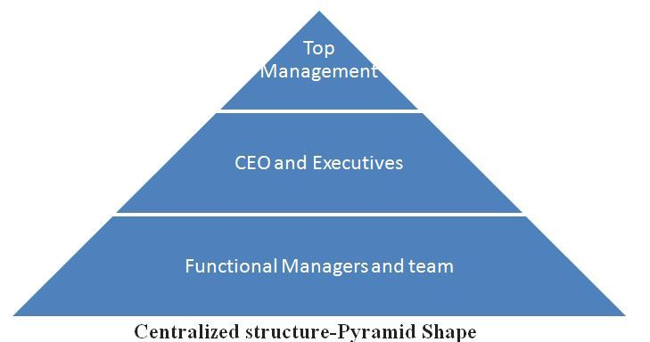
Question: 09
CONCEPTS
Organizational Structure Is Of Two Types
1. Centralized Structure
Notes:
In this type of organizational structure, all decisions, as well as processes, are defined; and handled by the top management. Employees and managers are responsible for the successful implementation of decisions and have to follow them. The employees low in the chain of command play a minimal role in the process of decision-making. Few real-life examples of such organizations are Army, companies like Flipkart, Apple, McDonald’s, etc. where the power of decision- making is held at the top level and there is a wide chain or hierarchy of managers and subordinates. Thus, the centralized structure has a top-down approach for decision flow.

Slide 34
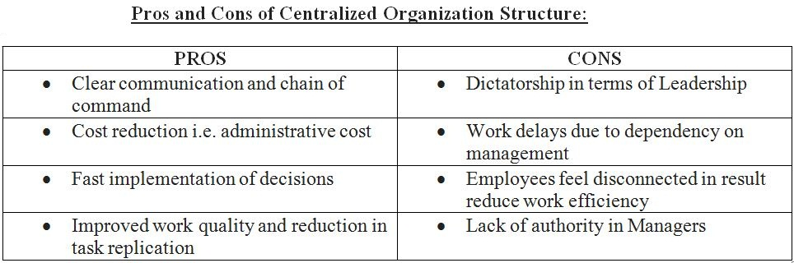
Question: 09
CONCEPTS

Slide 35
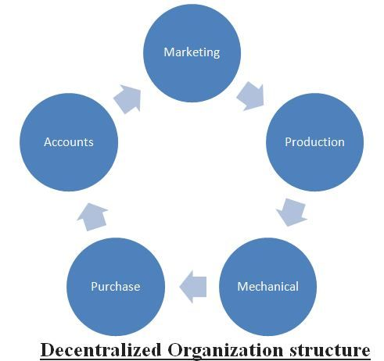
Question: 09
CONCEPTS
2. Decentralized Organization Structure
Notes:
In such type of organizations, day-to-day tasks and the decision-making processes are delegated to the supervisors at the middle and lower level by the top management for fast and effective decisions and to improve efficiency. By letting the middle and lower level executives jump in the process of decision-making, the top management can focus on other major decisions. This also increases the responsibility and accountability of the employees.
For Example; Mark, the HR Manager at ABC Company, has to finalize a deal with a vendor at a job portal for hiring and, for this, he negotiates best prices with discounts to close the deal. If his organization is a centralized one, then he will first seek senior management permission to finalize the deal and wait for their approval. If there is a delay rendered by the management part, he might lose the deal. However, if his company is decentralized, then, he has authority to close the deal all by himself with the vendor without seeking any approval from the management which, in turn, results in finalizing cost-effective and quick decision-making.

Slide 36
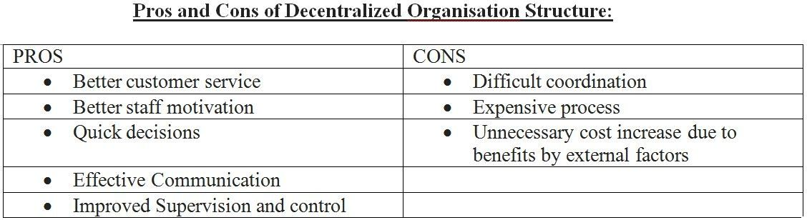
Question: 09
CONCEPTS

Slide 37
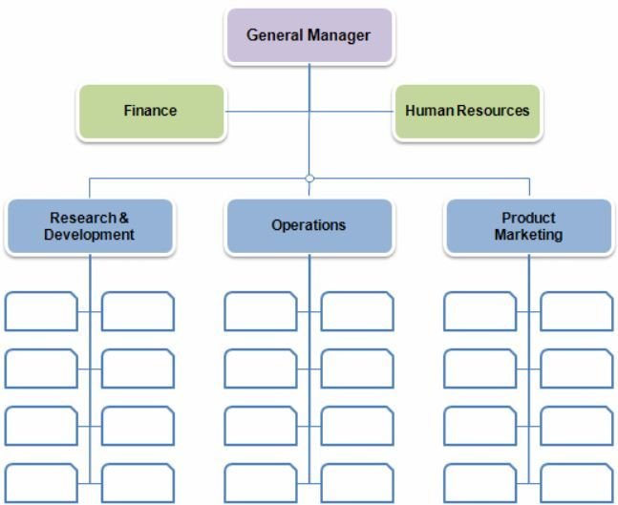
Question: 09
CONCEPTS
Organizational Design
Notes:
In simpler terms, “Organizational Design” refers to defining, designing, and re-structuring organizational structure. The very process of organizational design is aimed at finding any type of defective or dysfunctional elements related to an organization’s system, organization structure, process, and work culture. Identification of these elements leads to their rectification so that they can better fulfil an organization’s objective.
It clarifies different aspects like authority, the responsibility of tasks and its limitations, reporting structure, a flaw of information, etc. With the help of organizational design, one can identify and eliminate any kind of duplicity in work, inefficient work, poor customer dealing, blame games, obstacles in the decision-making process, shortfalls in systems, and processes which result in the decline of efficiency of the employees, lack of trust among superiors and subordinates, etc.
So, organizational design and organizational structure are interrelated to each other, yet have a slight difference. The organizational structure represents organizations in an immovable or static form that can be presented through a diagram, popularly known as “Organogram.” These diagrams or organization charts provide an easy interpretation of different functions of organizations and their relationships. Also, they show a hierarchy of the staff i.e. managers, leaders, other team members, and supervision levels.In contrast, the organizational design represents the dynamic view of an organization. It is more of processes and methods which help in organizational structuring and restructuring for smooth and effective functioning. It is also based on change management whereby the organizational demands change their structure and functioning to meet needs for technological advancements, market factors, meeting regulations, customer needs and expectations, etc. With the help of the organizational design, weaker systems of an organization can be identified and corrective steps can be taken to strengthen them.

Slide 38




THANK YOU
+91 78150 95095
codemithra@ethnus.com
www.codemithra.com

